Slide 1


Sonar Rock vs Mine Prediction System
SUBMITTED BY
Muhammad Israr
Fahad Naeem
Artificial intelligence

Slide 2
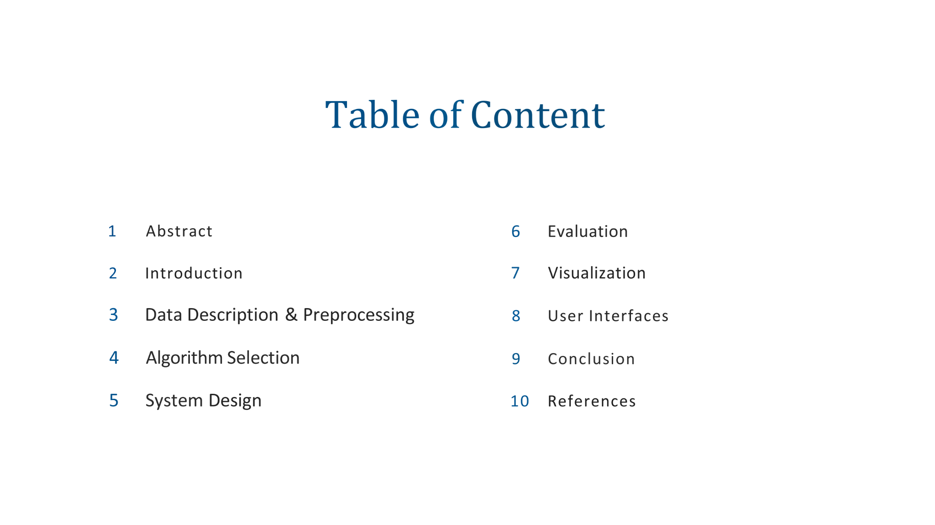

Slide 3


Abstract
Objective: To build a system that automatically classifies underwater sonar signals as either "Rock" or "Mine".
Technique: Utilized the K-Nearest Neighbors (KNN) machine learning algorithm.
Outcome: A Python-based GUI application was developed that achieves high accuracy on the test dataset.
Target Classification
Impact: Reduces manual error in sonar signal analysis for naval safety applications.

Slide 4


Introduction
Sonar (Sound Navigation and Ranging) is critical for underwater exploration and defense. However, distinguishing between a natural Rock (R) and a man-made Mine (M) is difficult due to noisy signal reflections.
Manual
AI System
Slow & Error Prone
Instant & Consistent
This project automates this process by treating the 60 frequency bands of a sonar chirp as a "data fingerprint."

Slide 5
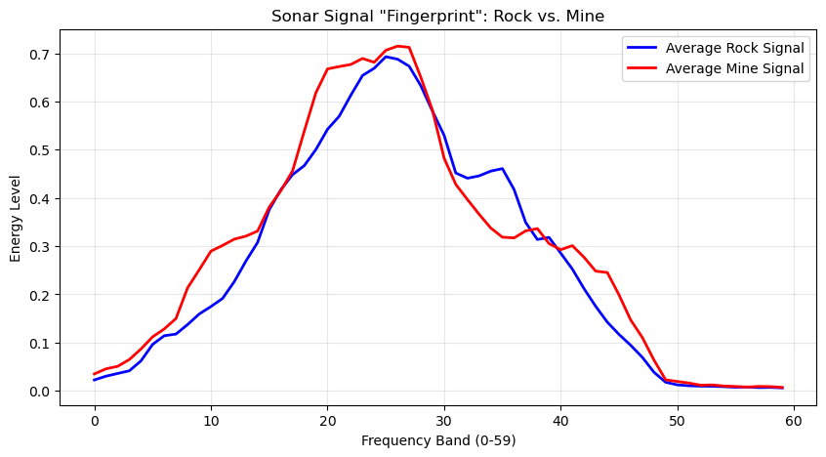

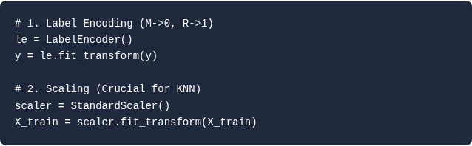
Data Description & Preprocessing
Dataset: Sonar.csv (UCI Repository).
Input (X): 60 Continuous numerical attributes (Energy in frequency bands).
Output (y): Binary Labels ('M' or 'R').
Preprocessing Code Implemented:

Slide 6
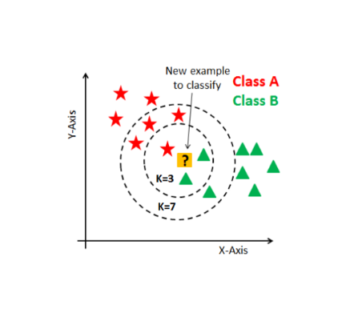
Algorithm Selection
Chosen Model: K-Nearest Neighbors (KNN)
Why KNN? It is a non-parametric, lazy learning algorithm perfect for recognizing clusters of signal patterns without assuming a specific data distribution.
Configuration:
n_neighbors = 3: Checks 3 closest matches.
Metric: Euclidean Distance.

Slide 7





System Design
The application follows a modular MVC-style architecture using Tkinter class structure.
1. Backend
2. Frontend
3. Visualization
Pandas & Scikit-Learn handle data loading, splitting (70/30), and model training.
Tkinter SonarGUI class manages the window, buttons, and label updates.
FigureCanvasTkAgg embeds Matplotlib charts directly into the GUI.

Slide 8

Evaluation
Train/Test Split: The model was trained on 70% of the data (approx 145 samples) and evaluated on the remaining 30% (63 samples).
~92.06%
Performance: The model correctly identified the majority of Mines and Rocks.
Testing Accuracy
(Random State = 42)
Generalization: Scaling ensures the model works on new signal intensities, not just the specific training examples.

Slide 9

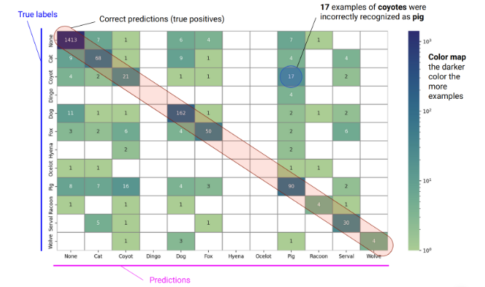
Visualization
Confusion Matrix Analysis
We generated a Heatmap to visualize errors:
•
Diagonal (Dark Blue): Represents correct predictions (True Positives & True Negatives).
•
Off-Diagonal (Light): Represents the few misclassifications (e.g., predicting a Mine is a Rock).
Code used: sns.heatmap(cm, annot=True, cmap='Blues')

Slide 10
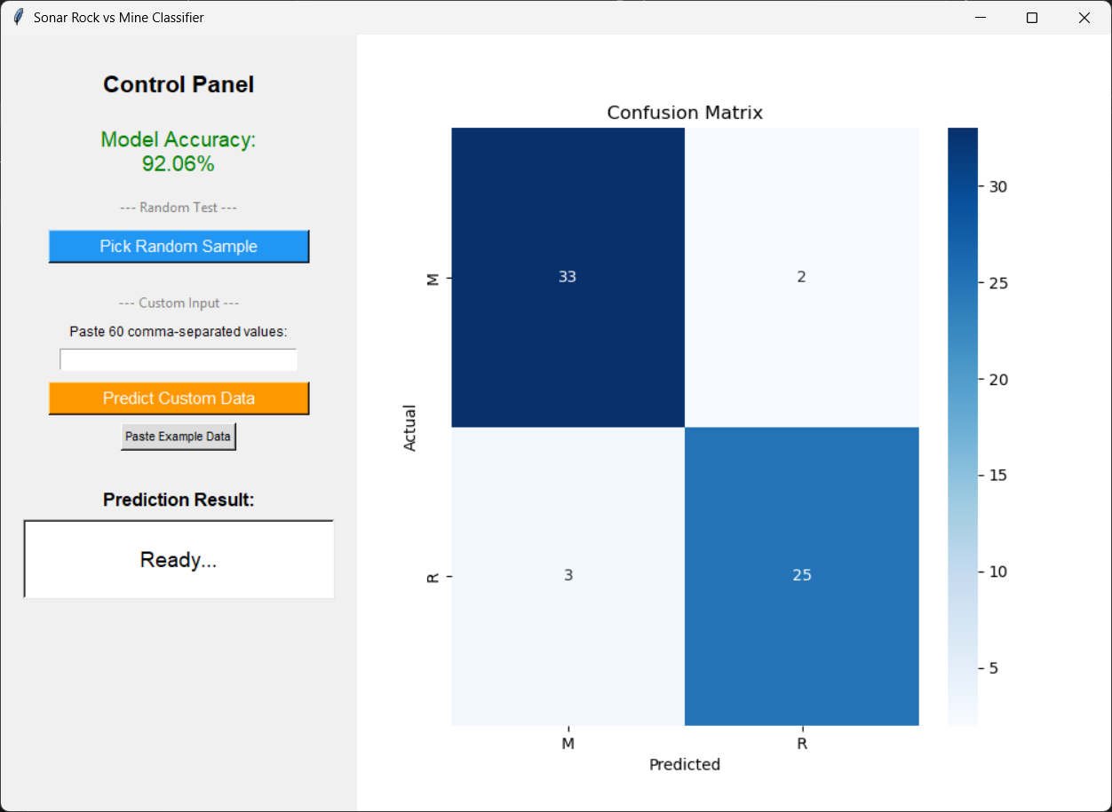
User Interfaces
We built a functional GUI to make the AI accessible.
Control Panel: Allows users to trigger predictions.
Real-Time Simulation: The "Test Random Sample" button pulls a random row from the test set and runs the prediction instantly.
Feedback: Displays "Predicted: Rock/Mine" with color coding (Green for correct, Red for incorrect).

Slide 11


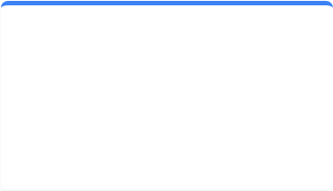
Conclusion
Success
Learning
Future
Successfully implemented an end-to-end classification pipeline with >85% accuracy.
Mastered the integration of Machine Learning (Scikit-Learn) with Desktop GUIs (Tkinter).
Plan to implement Hyperparameter Tuning (Slider for K) and support for live sensor data.

Slide 12
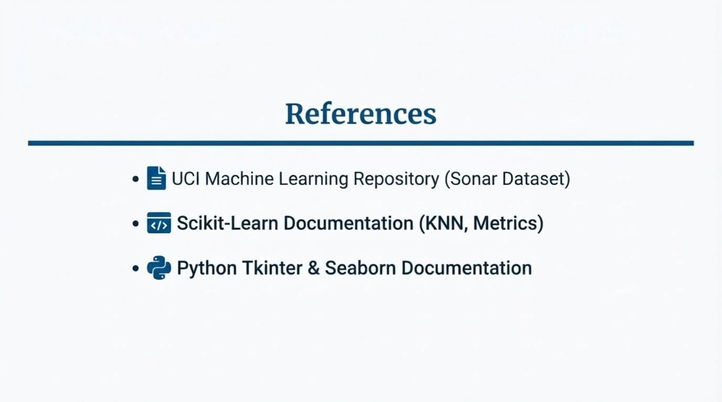

Slide 13


